Slide 1
Volume 1
Chapter 1: Introduction to Infection Prevention and Control (IPC)
IPC for Healthcare Setting in Ethiopia

Slide 2
Chapter Outline
Chapter Objective
PPP 1.1: Definition of basic terms
PPP 1.2: Goal of IPC
PPP 1.3: WHO Core components of IPC
PPP 1.4: The infection chain/cycle

Slide 3
Chapter Outline cont’d
PPP 1.5: Breaking the chain/cycle of infection
PPP 1.6: Understanding healthcare associated Infections
PPP 1.7: Good IPC Practice

Slide 4
Chapter Objective
At the end of this module, participants will be able to:
Define basic terms such as infection prevention and control
Describe the goal of IPC programs
Explain the WHO’s core components for Infection prevention and control
Explain the disease transmission cycle and measures to halt the spread of disease at health care delivery setting

Slide 5
Chapter Objective
Cont’d…
Understand what HAI’s are
Describe the role of standard precaution and transmission based precautions in preventing Healthcare Acquired Infections
Identify the recommended activities to improve IPC practices

Slide 6
PPP 1.1: Definition of basic terms

Slide 7
Definition of Basic Terms
Microorganisms: causative agents of infection
Infectious Microorganisms: microorganism capable of producing disease in appropriate hosts.
Colonization: presence and multiplication of a microorganisms without tissue invasion or damage
Infection: colonizing organisms are now causing Cellular response

Slide 8
Definition cont’d …
Infection prevention and control: a systemic effort or process of placing protective barriers (physical, chemical, or mechanical) between susceptible host & microorganism
    “used interchangeably with Infection Prevention in this training.”
Disease: any deviation from being health or interruption of the normal structure or function of any body part manifesting by signs and symptoms

Slide 9
Definition cont’d …
Protective Barriers: are physical, mechanical or chemical processes that prevent the spread of infectious microorganisms from person to person
Nosocomial infections: Infection arising > 48 hours after admission.
  Used interchangeably with “healthcare facility acquired infection” or “healthcare associated infections (HAIs)”.

Slide 10
Why Infection Prevention?
To protect patients from nosocomial infections
To protect the healthcare providers and support staffs from occupational hazard
To protect visitors
To protect students practicing in the healthcare facilities
To protect communities and environment

Slide 11
PPP 1.2: Goal of Infection prevention and control

Slide 12
Goal of Infection Prevention and Control
To make healthcare facilities safe place for all, including
  patients,
  clinical and
  non-clinical staff of healthcare facilities, and
  the community.

Slide 13
PPP 1.3: WHO Core Components of Infection Prevention and Control

Slide 14
WHO Core components of IPC
WHO has provided guidance on eight core components for Infection Prevention and Control (IPC)
Implementation success in each of these areas also depends on the adoption of a multimodal approach.

Slide 15
WHO Core components Cont’d …
Multimodal Strategy consists of several elements implemented in an integrated way with the aim of improving an outcome and changing behavior.
The presence of an IPC programme is a necessary, but not a sufficient condition to achieve safe and high quality health care.

Slide 16
The 8 WHO’s Core components are:-
IPC programme
Evidence-based guidelines
Education and training
Health care-associated infection (HAI) surveillance
Multimodal strategies
Monitoring and audit of IPC practices and feedback
Workload, staffing and bed occupancy ( facility level)
Built environment, materials and equipment for IPC (facility level)

Slide 17
PPP 1.4: The Infection Chain/Cycle

Slide 18
The Infection Chain/Cycle
Most microorganisms can cause infection.
Humans are susceptible to most infectious agents unless immune
Risk of infection is related to the number and virulence of organisms.
Number of organisms needed to cause infection varies with location (blood stream—least; intact skin— greatest number of organisms).

Slide 19
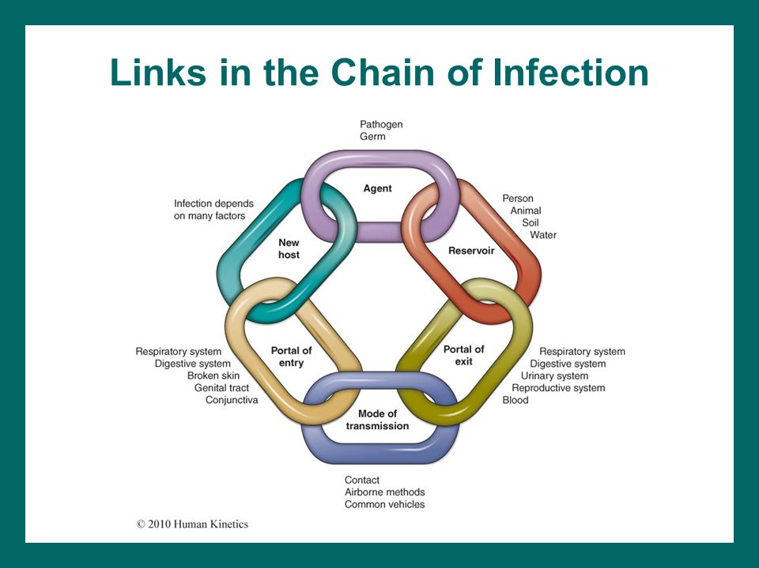
Chain of Infection

Slide 20
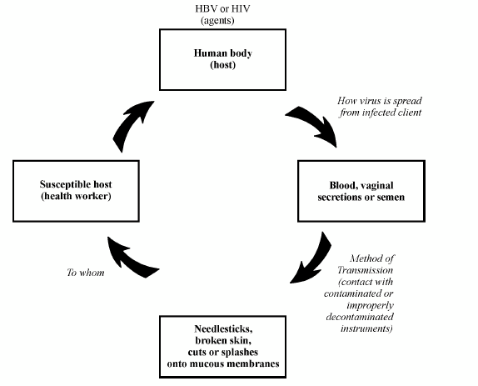
Chain of Infection cont’d …
Transmissions of HBV and HIV from Patients to Healthcare Workers

Slide 21
PPP 1.5: Breaking the chain/Cycle of infection

Slide 22
Breaking the chain/cycle of infection
Understanding the Chain of Infection or Transmission Cycle of specific infectious diseases is important, if healthcare workers are to:
  Prevent transmission of microorganisms
    From patient to patient,
    From patient to the provider or vice versa during medical and surgical procedures;
  Teach others on the factors required for transmission to occur and most importantly.
  Teach others on how to break the disease transmission cycle;

Slide 23
Breaking the chain/cycle of infection Cont’d …
Preventing the spread of infectious agents or proper infection prevention and control practice requires breaking the chain of infection by removing one or more of the conditions necessary through practices which;
  Reduce the number of microorganisms present (e.g. hand washing, cleaning of instruments)
  Kill, inhibit or inactivate microorganisms (e.g. hand washing with a waterless alcohol preparation, decontamination of patient care items);

Slide 24
Breaking the chain/cycle of infection Cont’d …
  Create barriers to prevent infectious agents from spreading (e.g. wearing gloves or personal protective equipment); or
  Reduce or eliminate risky practices (e.g. by using hands-free technique in the operation room, using gloves and disposable syringes etc.)
  Make sure that people, especially healthcare workers, are immune or vaccinated

Slide 25
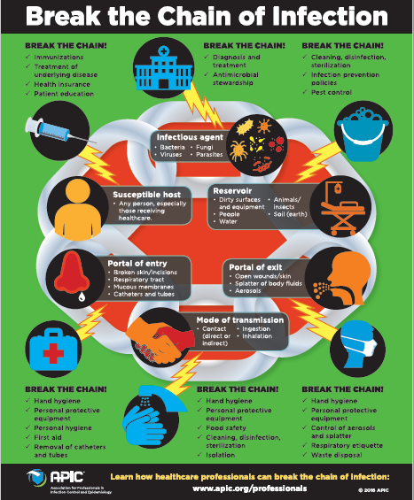

Slide 26
Breaking the chain/cycle of infection Cont’d …
Failure to apply infection prevention and control measures in healthcare settings can increase the risk for Healthcare Associated Infections.

Slide 27
PPP 1.6: Understanding Healthcare Associated Infections

Slide 28
Healthcare associated infections
Infections acquired while a patients is under hospital (or any other health facility) care which are not present or incubating at time of admission.
Infections occurring more than 48 hours after admission

Slide 29
Healthcare associated infections Cont’d …
HAIs may also occur;
  up to 48 hours after the episode of care
  up to 3 days after discharge
  up to 30 days after an operation
  up to 1 year after an operation with an implant

Slide 30
Healthcare associated infections Cont’d …
HAIs may be endogenous (from self) where the infectious agents is from patient like the normal flora which causes disease as a result of gaining access into another part of the body where it is not normally found .
Example organism from the colon entering the urinary tract and causing Urinary Tract Infection.

Slide 31
Healthcare associated infections Cont’d …
HAIs may also be exogenous (from others or cross infection).
This involves acquiring infection from an external source;
  For example a patient or health worker, through contaminated hands, or contaminated patient care items or the environment.

Slide 32
Healthcare associated infections Cont’d …
Some of the most common HAIs are;
  Surgical Site Infections
  Urinary Tract Infections,
  Blood Stream Infections,
  Pneumonia
  Diarrhea
Infection prevention practices are crucial for reducing the risk for any type of HAI with application of an understanding of the chain of infection or transmission cycle.
Two sets of practices for Infection prevention are;
  Standard Precautions and
  Transmission-Based Precautions.

Slide 33
1.7: Infection Prevention and Control Practice

Slide 34
Infection Prevention and Control Practices
Infection prevention and control practices include:
  Standard precaution and
  Transmission-based Precautions.

Slide 35
Infection Prevention and Control Practices cont’d…
Standard Precautions:
These practices are designed for use in caring for all people-both clients and patients attending healthcare facilities (first level precautions).
These apply to blood, all body fluids, secretions and excretions (except sweat), non-intact skin and mucous membranes.
Since no one really knows what organisms do clients or patients have, it is necessary that standard precautions be used all the time.

Slide 36
Infection Prevention and Control Practices cont’d…
Transmission-Based Precautions:
The second level precaution is intended for use in patients known or highly suspected of being infected or colonized with pathogens transmitted by:
  Air (tuberculosis, chicken pox, measles, etc)
  Droplet ( flu, mumps and rubella); or
  Contact (hepatitis A or E and other enteric pathogens, herpes simplex and skin or eye infections).

Slide 37
Infection Prevention and Control Practices cont’d…
If there is any impending development of an infectious process in a patient without known diagnosis,
  Implementing Transmission-Based Precautions should be based on the patient’s signs and symptoms (empirical basis) up until a definitive diagnosis is made.

Slide 38
Infection Prevention and Control Practices cont’d…
In all cases (whether they are being used alone or in combination),
  Transmission- Based Precautions must be used in conjunction with the Standard Precautions.

Slide 39
Group Work
Identify and break the Chain of infections for the following diseases
  Group 1: Cholera
  Group 2: Hepatitis B
  Group 3: HIV

Slide 40
Summery
The goal of infection prevention and control is to make health care facilities a safer place and WHO’s components of infection prevention and control is an integral part of this guideline.
Understanding each step of infection chain or cycle is a one step forward in prevention and control of HAI’s.
Always Apply Standard Precaution and Transmission based precaution as appropriate.
Infection prevention and Control activates are every body’s responsibility.

